Slide 1


Welcome to my presentation
Submitted by : Mitu Rani Pal
Roll no: 08
Batch : 09
Topic Name : Introduction to MS Office Applications

Slide 2

Computer fundamental and office applications
This Photo by Unknown Author is licensed under CC BY-NC

Slide 3
Topic of Microsoft Word:
Tables
References
Hyperlink
Insert picture
Bookmark
Page orientation
Layout
Table of content
shape
Shorting
Bangla typing
Alignment
Design
Creating smart art
Superscript & subscript
Bulleting

Slide 4
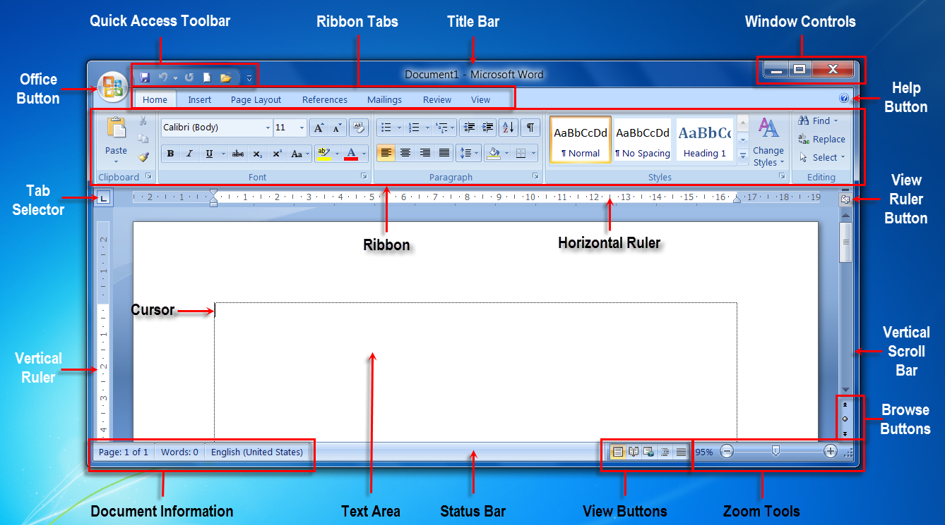
Home page of Microsoft Word:
This Photo by Unknown Author is licensed under CC BY-SA

Slide 5
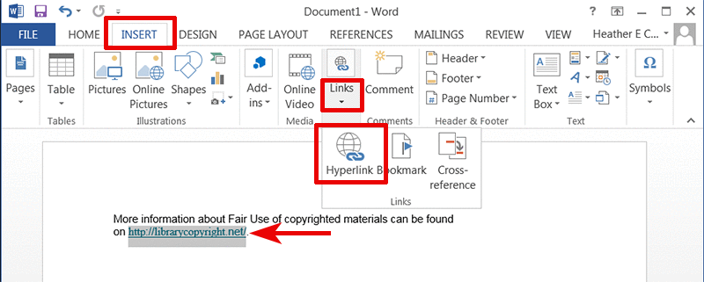
Function of insert:
This Photo by Unknown Author is licensed under CC BY-SA-NC

Slide 6
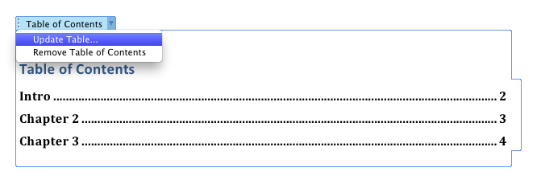
Table of content:
This Photo by Unknown Author is licensed under CC BY-SA

Slide 7
Topic of Microsoft Excel:
Create formula
Addition
Subtraction
Average
Excel formula
IF Function
COUNT Function
Vlookup Formula
Hlookup Formula
SUM Formula
SUMIF Formula
Index Match
Pivot Table

Slide 8
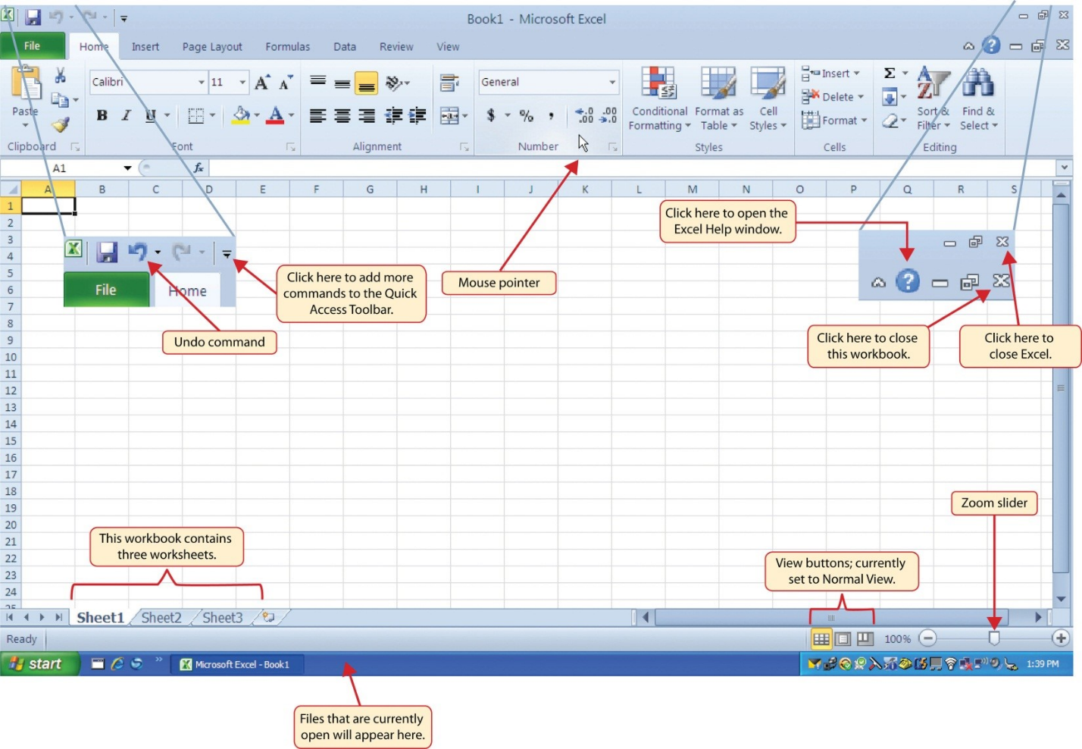
Home Tab of Microsoft Excel:
This Photo by Unknown Author is licensed under CC BY

Slide 9
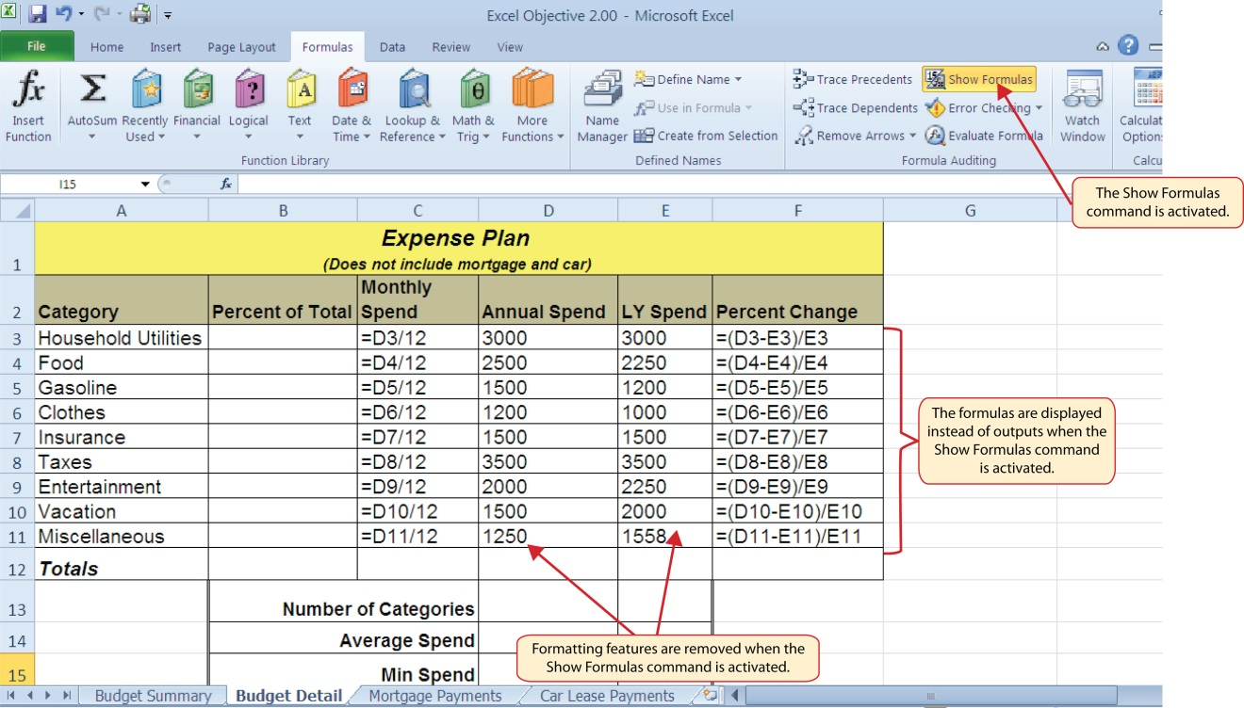
Create formula in Excel:
This Photo by Unknown Author is licensed under CC BY

Slide 10
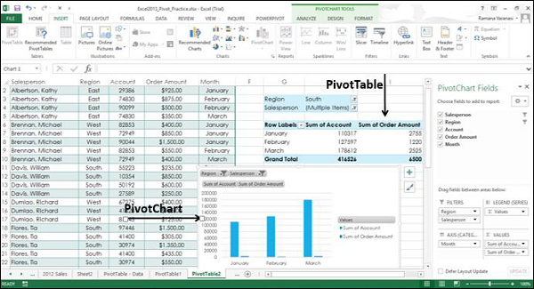
Insert PivotTable & PivotChart:
This Photo by Unknown Author is licensed under CC BY-SA

Slide 11
Topic of Microsoft PowerPoint:
Add shapes
Choose a theme
Insert clipart, video, audio, etc
Format your text
Animations
Transitions
Insert new slide
Slide show

Slide 12
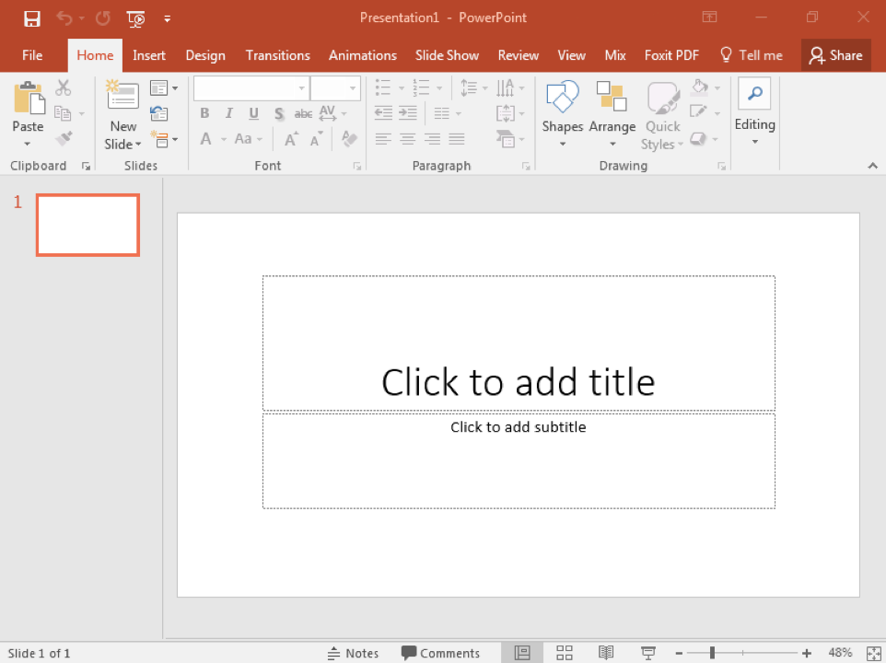
Home page of PowerPoint:
This Photo by Unknown Author is licensed under CC BY

Slide 13
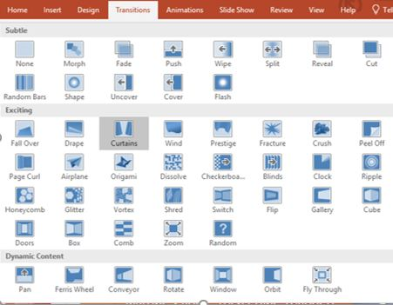
Transitions of PowerPoint:
This Photo by Unknown Author is licensed under CC BY-SA-NC

Slide 14
Thank you all & my honorable teacher

